Slide 1

DEPARTMENT OF COMPUTER SCIENCE ENGINEERING A Mini Project Presentation (BATCH-11) ON PREDICTING THE NBA USING TWITTER: BASED ON SUPPORT VECTOR MACHINE (SVM) SUPERVISED LEARNING ALGORITHM

Slide 2
Project Co-coordinators:- Mr. T. G. Vasista(Assistant Professor, CSE) Mr. E. Krishna(HOD, CSD) Project Guide:- Mrs. G. Harika(Assistant Professor, CSE)
Team Members | Hall Ticket Numbers
1. K. Ashwini | 196F5A0513
2. B. Lalitha Priya | 186F1A0506
3. S. Karthik Kumar | 186F1A0543
4. G. Deekshith | 196F5A0511
5. K. Karunakar Reddy | 186F1A0529

Slide 3
Problem Statement
The main objective of this project is to use Twitter API, Machine Learning, Deep Learning and natural language processing skills to predict the game results of NBA (National Basketball Association) based on the tweets on NBA. Thus, more business opportunities maybe detected and utilized not only for NBA but also for other relevant sport leagues.
Commercial and Social Betting on sports like National Basketball Association (NBA) is very common in countries like USA [1]. Therefore, Predicting the outcome of NBA matches as win or lose poses a challenges to the corresponding communities [2]. The League also introduced its new social media like Twitter for informing the goal status of the game, and the tweets made by twitter users

Slide 4
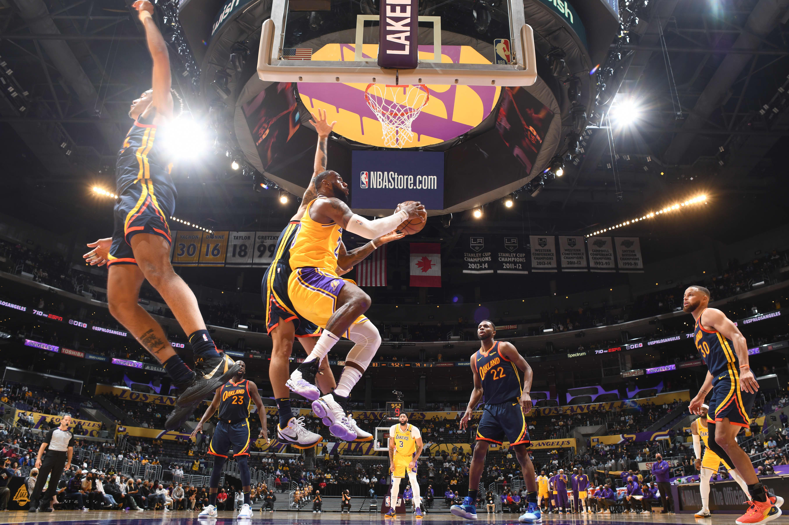
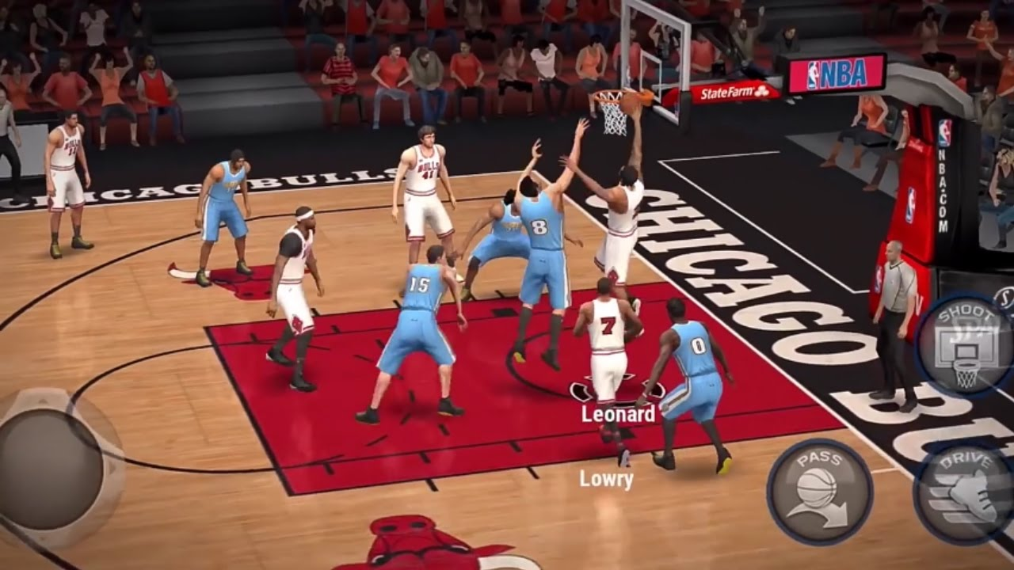
Introduction
What is NBA?
NBA stands for National Basketball Association
The National Basketball Association (NBA) is a professional basketball league in North America. The league is composed of 30 teams (29 in the United States and 1 in Canada) and is one of the four major professional sports leagues in the United States and Canada.
It is the premier men's professional basketball league in the world which is played in the indoor.
The NBA is now the second most watched sports league in the US, and the tenth most followed sport in the world.
There are total 30 teams in the NBA league and can be divided by 15 teams respectively in Eastern and Western conferences
Rules of NBA
1. The ball may be thrown in any direction with one or both hands.
2. The ball may be batted in any direction with one or both hands (never with fist).
3. A player cannot run with the ball
4. No shouldering, holding, pushing, tripping or striking in any way the person of an opponent shall be allowed.
4. Score within the shot clock

Slide 5
Techniques used:
Machine Learning
Inferential Statistics
Sentiment Analysis
Deep Learning
Predictive Modelling
Data Visualization
Language, Libraries and Packages used:
We use Python to develop this project due to the fact that Python is powerful, flexible, and easy-to-use language.
1. Python, JupyterNoteBook
2. Numpy, Pandas, Sklearn, Nltk
3. Matplotlib, Scipy, Keras

Slide 6
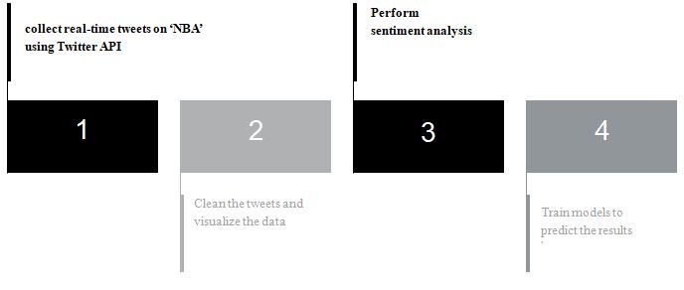
Process Overview
This process involves the collection of real-time tweets on ‘NBA’ using Twitter API, perform sentiment analysis on the tweets, and train various Machine Learning models to predict the outcome of different matches using counts of tweets on the two teams involved and the percentage of positive, negative and neutral tweets respectively
1. Collect real-time tweets on ‘NBA’ using Twitter API.
2. Clean the Tweets(using Data Pre-processing) and visualize the data(using various patterns)
3. Perform Sentiment Analysis
4. Train models to predict the results

Slide 7
Project Description
1. There are total 30 teams in the NBA league and can be divided by 15 teams respectively in Eastern and Western conferences.
2. Since we cannot obtain the data for more than past 30 days from the standard twitter API, we move on to find another way to gain the data.
3. We apply twitter search engine to receive the tweets related to “NBA teams” in 2019 and 2020.The basic idea is to request directly from tweets and then return them as JSON files.
Initial Text Analysis:
At first, we do not know which methodology has the best performance for this project. Therefore, we consider and decide to try three possible ways (Highest Frequency Words, Injury and Recovery Factors and Sentiment Analysis) to test with our sample dataset as our first step.

Slide 8
Highest Frequency Words:
1.Separate the entire dataset into three subset datasets based on the time period and they are "3 days", "7 days" and "1 month" individually.
2.Remove the useless contents such as 'twitter', 'http', 'com', 'pic', 'ift', 'tt', 'https' and so on.
3.After pointing out the top 20 highest frequency words in each time period, we take 5 most meaningful words for the demonstration.
4.However, the results are not good enough to make the game predictions accurately.
Injury and Recovery Factors:
1.In this section, we are more interested in finding some influential factors which could affect the results of the games.
2.Therefore, we wonder if there are injured players or recovered players in the team because they may have huge influences on the game results if they are key players for that team.
3.Here are some common key words for tweets related to injury and recovery words:
Injury words (Negative): ￼￼￼['hurt','injury','injured','broken','tear','missed','ill', 'illness']
Recovery words (Positive): ￼￼￼￼['recover','recovery','return','health','healthy','heal', 'back', 'rehab']
4.After that we count these words and determine if Injury words > Recovery words then which means it is a bad expectation for that team.
5.Otherwise, if Recovery words > Injury words then which means it is a good expectation for the team.

Slide 9
Sentiment Analysis:
1. First of all, we count the amount of positive/negative words from all tweets. Once the amount of positive words greater than negative words we treat it as a good result.
2. In addition, if good results are more than bad results 24 hours before the competition, we predict the result of the game is to win.
3. Furthermore, we apply TF-IDF model to filter tweets and discover this accuracy is much higher than the previous ones.
After processing three different kinds of methodologies, we find out that Sentiment Analysis has the best performance at the end; therefore, we determine to implement Sentiment Analysis with mentioned algorithms.

Slide 10
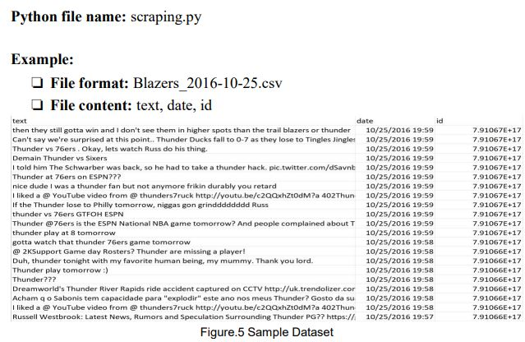
[6]

Slide 11
Algorithms Used:
Supervised Algorithm
1. Supervised learning is the type of machine learning in which machines are trained using well "labeled" training data.
2. In supervised learning, the training data provided to the machines work as the supervisor that teaches the machines to predict the output correctly.
3. It applies the same concept as a student learns in the supervision of the teacher.
Support Vector Machine(SVM)
1.Support Vector Machine is one of the most popular Supervised Learning algorithms, which is used primarily, for Classification problems in Machine Learning.
2.The goal of the SVM algorithm is to create the best line or decision boundary that can segregate n-dimensional space into classes so that we can easily put the new data point in the correct category in the future.
3.SVM chooses the extreme points/vectors that help in creating the hyper plane.
4. These extreme cases are called as support vectors, and hence algorithm is termed as Support Vector Machine.
5.Types of SVM:
Linear SVM
Non- Linear SVM

Slide 12
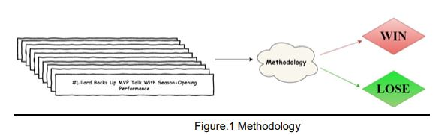

Slide 13
Methodology Approach In this section, we gain the accuracy of combining algorithms with and without Sentiment Analysis:
Supervised Learning Algorithms:
Naïve Bayes Classification
Support Vector Machine(SVM)
Unsupervised Learning Algorithms:
Accuracy of K-Means clustering
Accuracy of LDA
sentiment analysis | Non-Sentiment analysis
Around 50%-60% | Around 50%
Non sentiment analysis
Around 50%
sentiment analysis | Non-Sentiment analysis
Around 50%-60% | Around 50%
Non Sentiment analysis
Around 50%

Slide 14
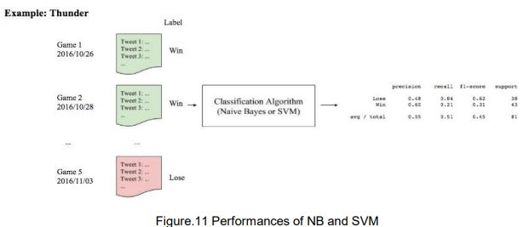
Implementation
We collect tweets before the game 24 hours and label them based on the real game results. We implement Naive Bayes and SVM function provided by sklearn package to calculate f1-scores.

Slide 15
Conclusion
After comparing with four different algorithms, we conclude that supervised learning algorithms (Naive Bayes and SVM) have better performances than unsupervised learning algorithms (K-means and LDA).[5] The possible reason is because labels utilized in supervised learning algorithms may strengthen the features of tweets; therefore, it can improve the accuracy of predictions in NBA game results.

Slide 16
References
1. Shlomo Sprung, (2021), Forbe.
Cheng G, Zhang Z, Kyebambe M & Kimbugwe N, (2016), ResearchGate, entropy.
Sinan Basarslan & Kayaalp F, (2020), Advances in Distributed Computing and Artificial Intelligence .
Chen, Kong, Kong, (2020), ScienceDirect.
Ge Cheng, Zhenyu Zhang, Moses Ntanda Kyebambe and Nasser Kimbugwe, 2016, ResearchGate.
Reference: https://github.com/Jefferson-Henrique/GetOldTweets-python

Slide 17


